Slide 1




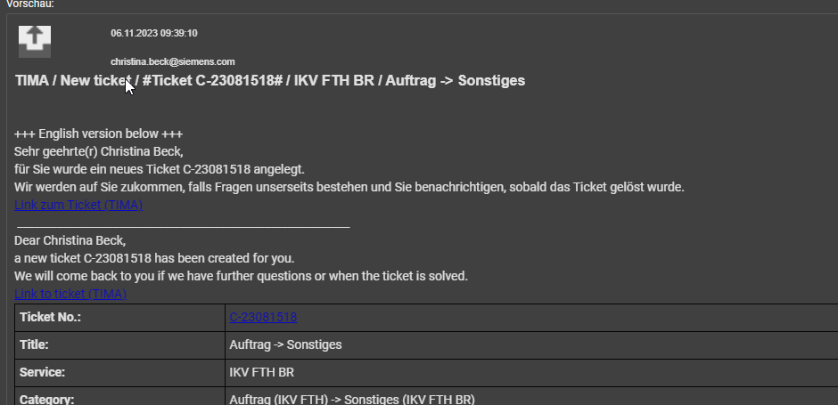
Inputs
Voice
Corner Points:
•Langague: German only
•Infere ticket type
•Infere ticket priority
•Tickets for only one groups, thus this does not need to
be infered
•The look of the interface is not important, this is a proof
of concept and thus only the perfomance is relevant
•The inputs are text (via Web App and Mail) and voice
(via Web App and maybe a call line)
•The user is to be notified about the created ticket
•Performance: Ticket creation time should not exceed
one minute
•The output ticket should be in some general language
like JSON, XML etc.
Backend
Frontend
Call
pure text
Text
Website
Sends input to the
backend
Feedback loop for
questions (best case
scenario: there are
no questions)
AI
Converter
Converts input into
pure text
What to prioritise:
•The precision of the created ticket compared to the
actual ticket. This means rather a slow answer but very
good ticket then the other way around
—> precision > performance
Mailserver
Ticket number is
send to the user
Nice to haves:
•Maybe the AI can even answer frequently ask questions
•For major incidents, the AI could recognise the
duplicate tickets and aswer them by informing the user
that this is a know problem and to please not call again
regarding this problem (MS down, or other major
things)
Ticket is created
from input
Email
send a structured email to tima
(no special interface is needed)
Requiered fields see Document „TIMA_1.6_Structured_Emails_Informationes“
I.B.
Not needed TIMA sends a email with all ticket informations
I.B.
Fields:
-Priority
-Title
-Description
-Request Type (Problem, Incidents, Service
Requests...)
-Affected Person
-Impact
Ticket
Additional materials we will recieve:
•The ticket input form / ticket fields with indications
which are required and which are optional
•examples from past tickets to see how the tickets
should look like
•Maybe calls / example voice recordings to know what
will be said to the AI
•Mails to see what people write
•Potentially access to the „Wissensdatenbank" / FAQ
and other documenation for the model to learn to
answer some tickets already.
Output

Slide 2
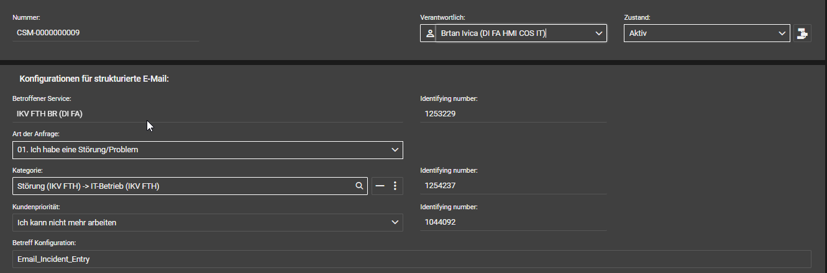
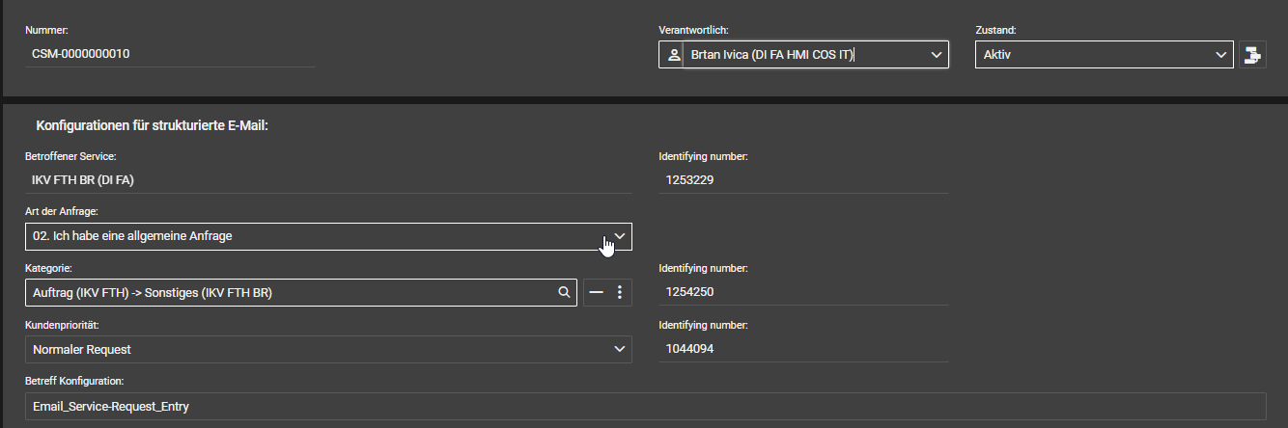
Service Overview
TIMA-Services
Configuration element 4 struc email
Testscenario Fürth – Structured Email
Email will sent to: tima.it@siemens.com
IKV ERL S SP1
Email_Incident_Entry
IKV FTH BR (DI FA)
IKV AMB WVS50
IKV KHE R (DI FA)
IKV NBG M
Email_Service-Request_Entry
TIMA IKV
Incident
###Title:Start###
###Title:End###
###Note: only one GID or e-mail address is allowed###
###AffectedPerson:Start###
###AffectedPerson:End###
###Note: only one GID or e-mail address is allowed###
###ReportingPerson:Start###
###ReportingPerson:End###
###Message:Start###
###Message:End###
###KindOfRequest:Incident
###CustomerPriorityID:1044092
###ServiceID:1253229
###CategoryID:1254237
Service Request
###Title:Start###
###Title:End###
###Note: only one GID or e-mail address is allowed###
###AffectedPerson:Start###
###AffectedPerson:End###
###Note: only one GID or e-mail address is allowed###
###ReportingPerson:Start###
###ReportingPerson:End###
###Message:Start###
###Message:End###
###KindOfRequest:ServiceRequest
###CustomerPriorityID:1044094
###ServiceID:1253229
###CategoryID:1254250
5 TIMA services (5 locations) must be differentiated during the evaluation (where does the user come from)
start with 2 differentiations 1 incident category / 1 service request category
(can be expanded later)

